Slide 1
MEAN AND VARIANCE OF A RANDOM VARIABLE

Slide 2
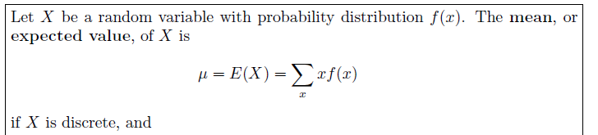

MEAN/EXPECTED VALUE OF SINGLE RANDOM VARIABLE

Slide 3



VARIANCE AND STANDARD DEVIATION OF A RANDOM VARIABLE
Standard Deviation

Slide 4

MEAN/EXPECTED VALUE OF JOINT RANDOM VARIABLE

Slide 5

From a box containing 4 black, 3 red and 2 green balls, 3 balls are drawn. Find the probability distribution for the number of green balls.
Find mean of X and standard deviation of X.
for x 0,1,2
X | P(x)
0 | 5/12
1 | 6/12
2 | 1/12

Slide 6
From a box containing 4 black, 3 red and 2 green balls, 3 balls are drawn. Find the probability distribution for the number of green balls.
Find mean of X and standard deviation of X.
for x 0,1,2
E(X)=∑XP(X)=8/12 =0.66
X | P(x) | XP(X)
0 | 5/12 | 0
1 | 6/12 | 6/12
2 | 1/12 | 2/12
 |  | ∑XP(X)=8/12

Slide 7

From a box containing 4 black, 3 red and 2 green balls, 3 balls are drawn. Find the probability distribution for the number of green balls.
Find mean of X and standard deviation of X.
for x 0,1,2
E(X)=∑XP(X)=8/12 =0.66
X | P(x) | XP(X) | X²P(X)
0 | 5/12 | 0 | 0
1 | 6/12 | 6/12 | 6/12
2 | 1/12 | 2/12 | 4/12
 |  | ∑XP(X)=8/12 | ∑X²P(X)=10/12
= [ 10/12 – (8/12)² ]
= 0.3977
= 0.630635

Slide 8
Find:
Mean of X and mean of Y
Variance of X and Variance of Y
E(XY)
 |  | X
 |  | 0 | 1 | 2 | 3 | P(Y)
Y | 0 | - | 1/30 | 2/30 | 3/30 | 6/30
 | 1 | 1/30 | 2/30 | 3/30 | 4/30 | 10/30
 | 2 | 2/30 | 3/30 | 4/30 | 5/30 | 14/30
P(X) |  | 3/30 | 6/30 | 9/30 | 12/30 | 1
X | P(X)
0 | 3/30
1 | 6/30
2 | 9/30
3 | 12/30
Y | P(Y)
0 | 6/30
1 | 10/30
2 | 14/30

Slide 9
Find:
Mean of X and mean of Y
E(X)=∑XP(X)=60/30=2
E(Y)=∑YP(Y)=38/30=1.267
 |  | X
 |  | 0 | 1 | 2 | 3 | P(Y) | YP(Y)
Y | 0 | - | 1/30 | 2/30 | 3/30 | 6/30 | 0
 | 1 | 1/30 | 2/30 | 3/30 | 4/30 | 10/30 | 10/30
 | 2 | 2/30 | 3/30 | 4/30 | 5/30 | 14/30 | 28/30
P(X) |  | 3/30 | 6/30 | 9/30 | 12/30 | 1 | 38/30
XP(X) |  | 0 | 6/30 | 18/30 | 36/30
X | P(X) | XP(X)
0 | 3/30 | 0
1 | 6/30 | 6/30
2 | 9/30 | 18/30
3 | 12/30 | 36/30
 |  | ∑XP(X)=60/30
Y | P(Y) | YP(Y)
0 | 6/30 | 0
1 | 10/30 | 10/30
2 | 14/30 | 28/30
 |  | ∑YP(Y) =38/30

Slide 10
Find:
Variance of X and Variance of Y
 |  | X
 |  | 0 | 1 | 2 | 3 | P(Y) | YP(Y) | Y²P(Y)
Y | 0 | - | 1/30 | 2/30 | 3/30 | 6/30 | 0 | 0
 | 1 | 1/30 | 2/30 | 3/30 | 4/30 | 10/30 | 10/30 | 10/30
 | 2 | 2/30 | 3/30 | 4/30 | 5/30 | 14/30 | 28/30 | 56/30
P(X) |  | 3/30 | 6/30 | 9/30 | 12/30 | 1
XP(X) |  | 0 | 6/30 | 18/30 | 36/30
X²P(X)
Var(X)
= [ 150/30 – (60/30)² ]
= 1
Var(Y)
= [ 66/30 – (38/30)² ]
= 0.557
X | P(X) | XP(X) | X²P(X)
0 | 3/30 | 0 | 0
1 | 6/30 | 6/30 | 6/30
2 | 9/30 | 18/30 | 36/30
3 | 12/30 | 36/30 | 108/30
 |  | ∑XP(X)=60/30 | ∑X²P(X) =150/30
Y | P(Y) | YP(Y) | Y²P(Y)
0 | 6/30 | 0 | 0
1 | 10/30 | 10/30 | 10/30
2 | 14/30 | 28/30 | 56/30
 |  | ∑YP(Y) =38/30 | ∑Y²P(Y) =66/30

Slide 11
Find:
E(XY)
 |  | X
 |  | 0 | 1 | 2 | 3
Y | 0 | - | 1/30 | 2/30 | 3/30
 | 1 | 1/30 | 2/30 | 3/30 | 4/30
 | 2 | 2/30 | 3/30 | 4/30 | 5/30
-
0
0
0
0
2/30
6/30
12/30
0
6/30
16/30
30/30
E(XY)=∑XYP(X,Y)
=72/30
=2.4

Slide 12

Means and Variances of Linear Combinations of Random Variables

Slide 13


Means and Variances of Linear Combinations of Random Variables

Slide 14
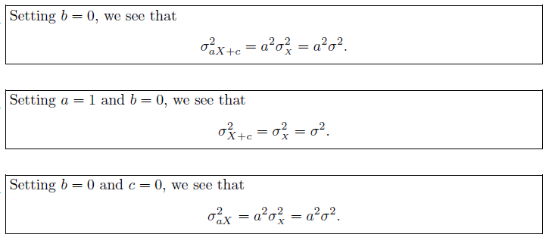
Means and Variances of Linear Combinations of Random Variables

Slide 15
ASSIGNMENT QUESTIONS
4.2
4.6
4.7
4.8
4.10
4.34
4.36
4.49
4.54
4.57
4.60
4.62

